Slide 1
附件 3.2
情緒紅綠燈

Slide 2
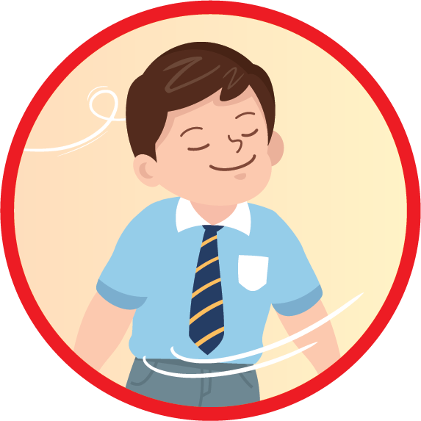
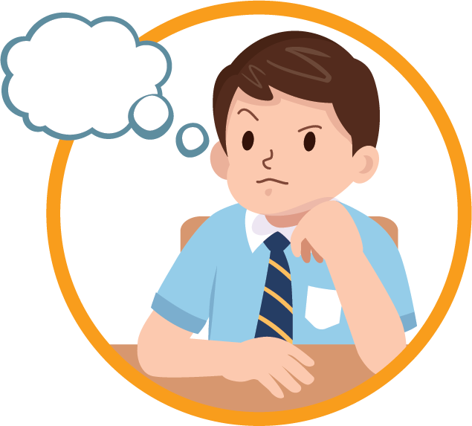
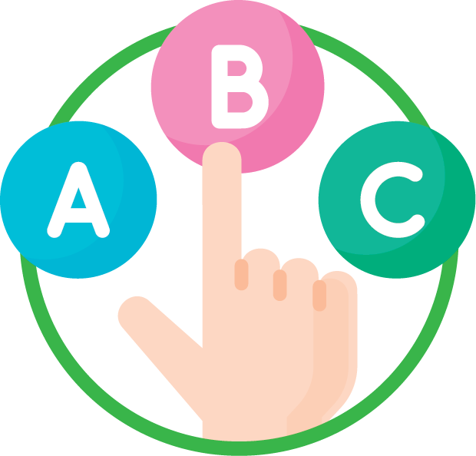
一二三，紅綠燈，情緒到，要小心！
當我留意到自己情緒太高漲而未能平復時，我可以
停
停一停，深呼吸
想
想一想，怎樣做
做
選擇效果最好的方法！

Slide 3
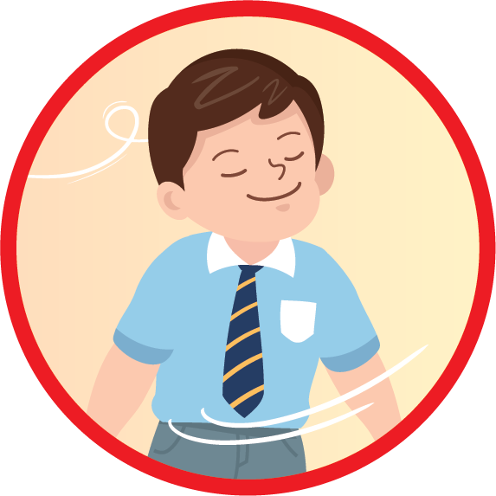
Red Light, Green Light, Stop, Think, Do.
When I find my feelings go too strong and cannot calm down, I can …
Stop
Stop and breathe.
Think
Think about what I can do.
Do
Select one with the best outcome!

