Slide 1
附件 3.3
情緒溫度計

Slide 2
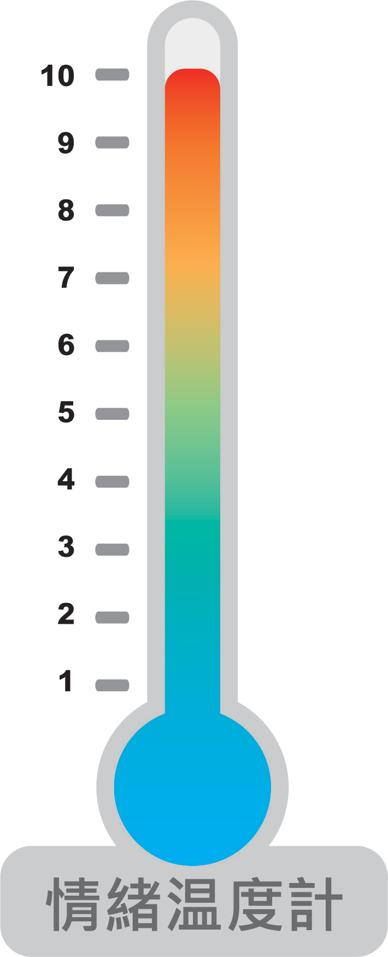
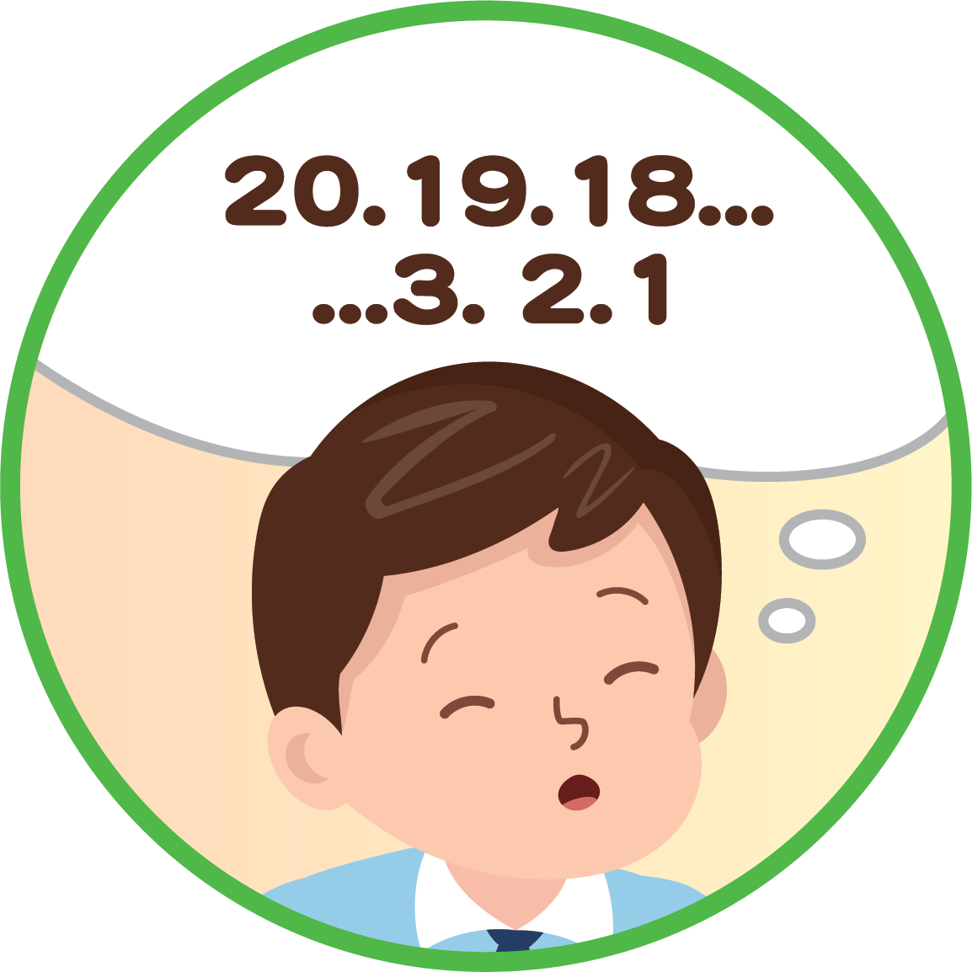
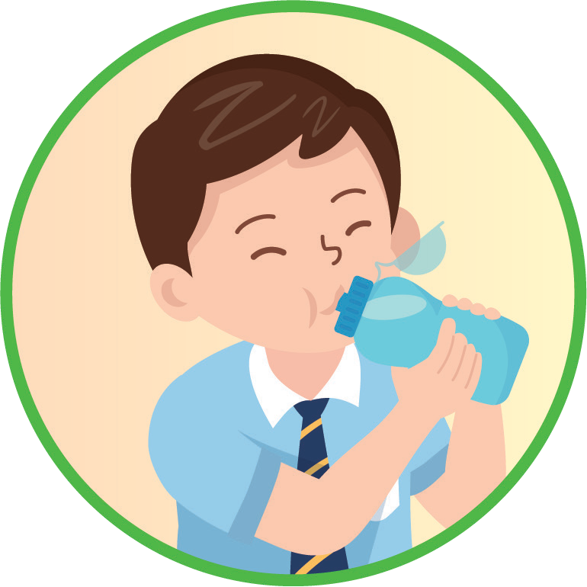
當我留意到自己的
情緒變得高漲時，我可以⋯⋯
極高漲
平靜
極冷靜
由20倒數至1
深呼吸，將悶氣呼出
洗個臉，喝點水

Slide 3
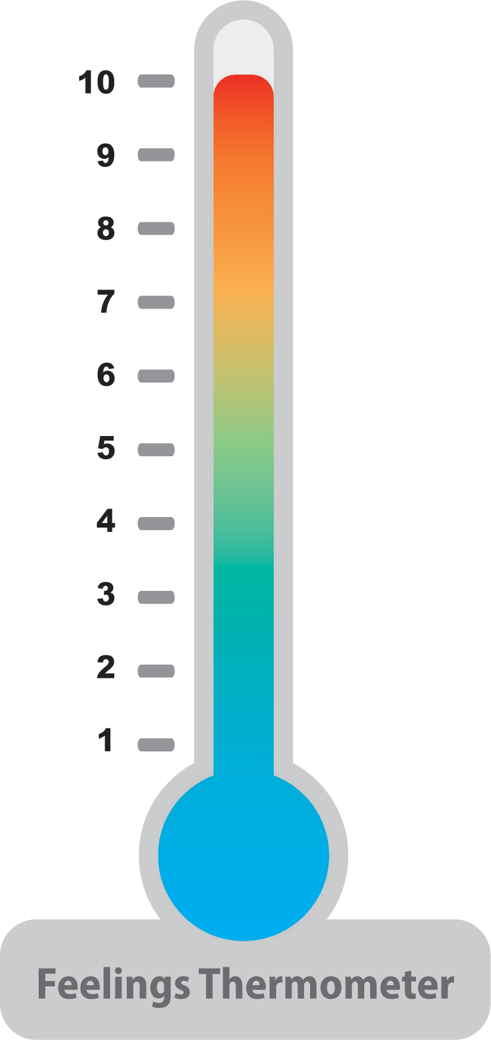
When I find my feelings getting too strong, I can ......
Too strong
Calm
Very calm
Count down from 20 to 1
Take deep breath
Wash my face Drink some water

