Slide 1
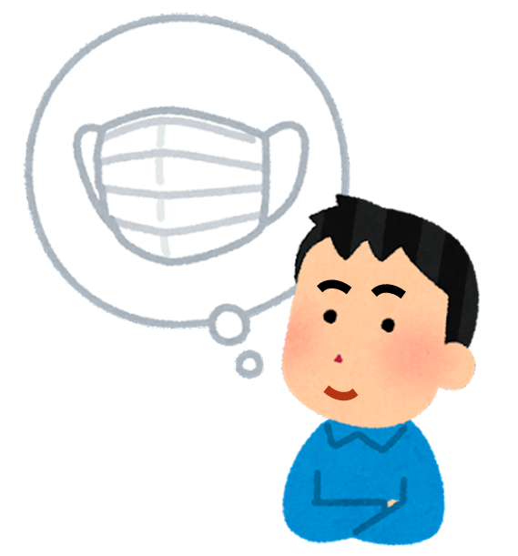
Life without Masks Easing Back into Normal Positively
February, 2023
(Parents or teachers should read with the students)

Slide 2
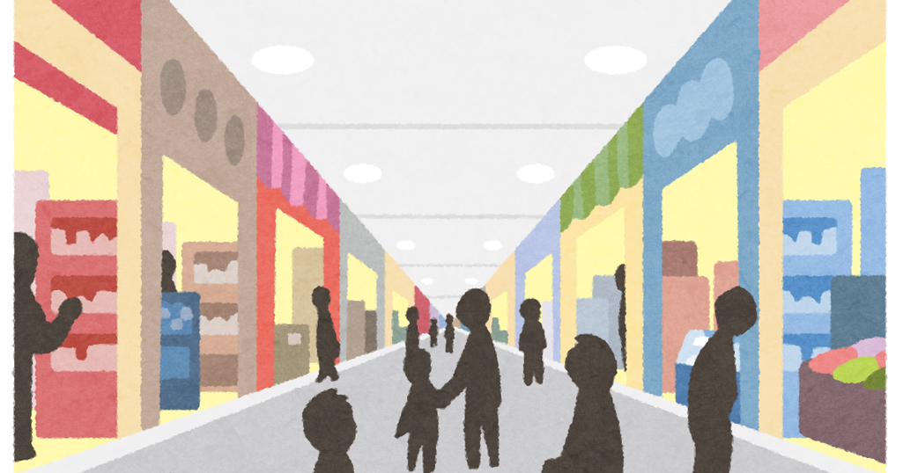
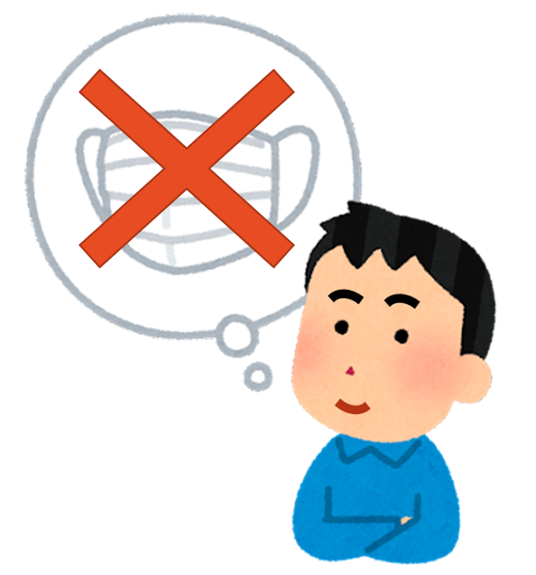
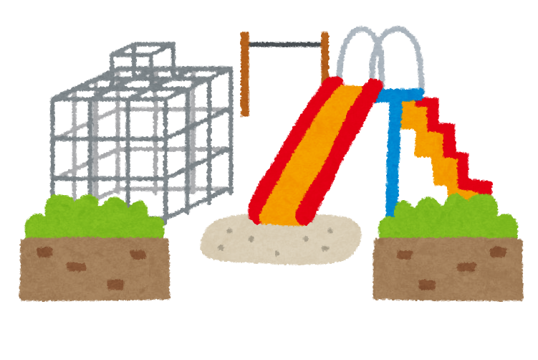
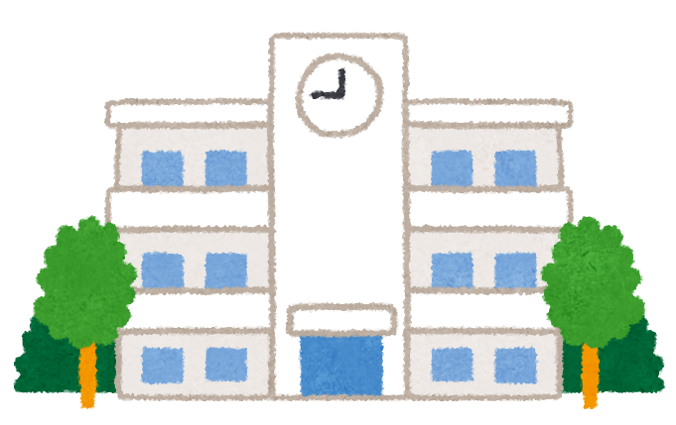
Recently, the impact of the pandemic on us has greatly subsided, our life gradually returned to normal.
The government has announced the lifting of the mask mandate. We no longer have to wear face masks in public areas, such as playgrounds, shopping malls or schools.

Slide 3
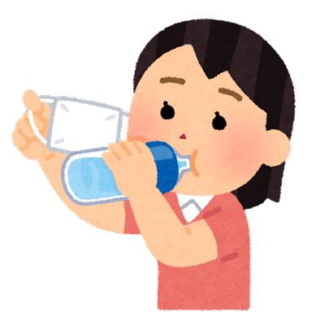
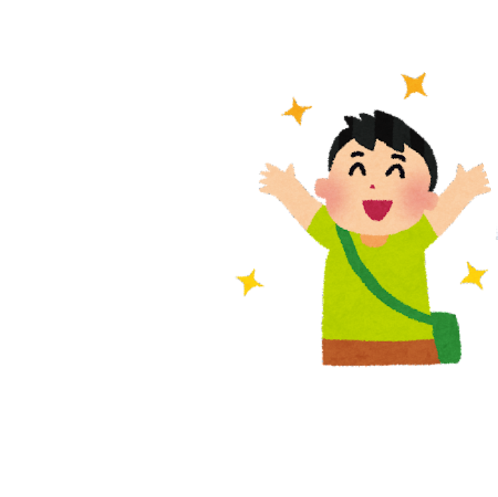
We used to take off our masks temporarily only during drinking or eating.
Now we can take off our masks, just like it was about 3 years ago before the epidemic.
In school, we will see the principal, teachers, classmates, and school workers without wearing masks.

Slide 4
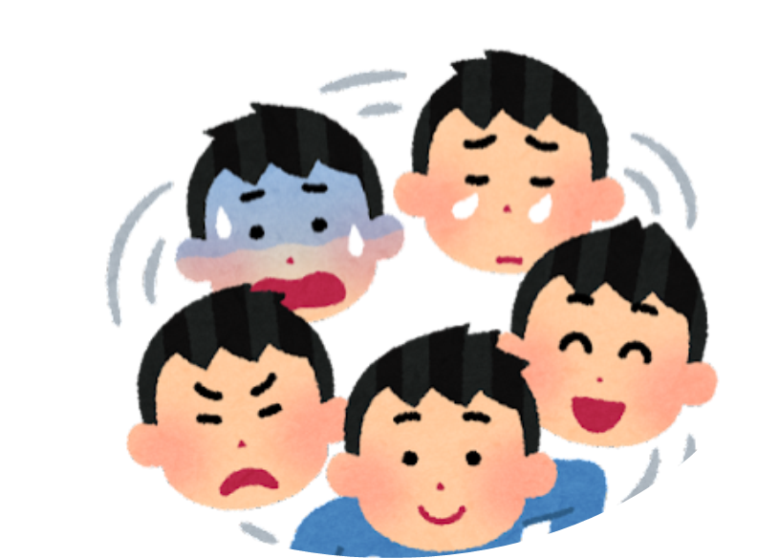
.
Without wearing a mask, we can see other’s facial expressions more easily when communicating with them.
I will see other people's face, and others will also see my face.
Therefore, we may need to pay more attention to our facial expressions when interacting with others.

Slide 5
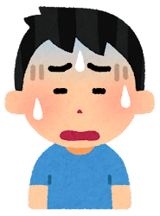
We may be happy because we can breathe comfortably;
We may also be worried,
because of the fear of getting sick or
others will pay attention to our face.

Slide 6
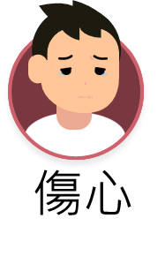
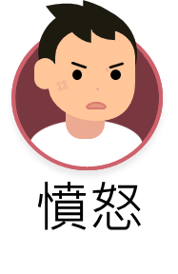
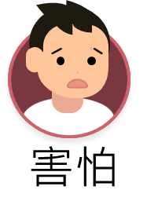
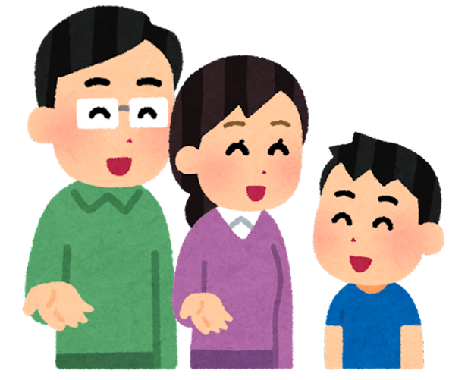
It is normal for us to have different emotions when facing change.
I can tell teachers and family members about my feelings or thoughts, and they will work with me to find ways to relieve my emotions.
I feel________________________,
because________________________.
Happy
Sad
Angry
Fear

Slide 7
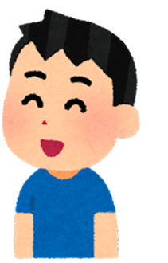
We can also think positively, and I know there are many benefits of not wearing a mask.
The epidemic has stabilized, the risk of infection has been greatly reduced . It's okay even if I don't wear a mask.
It will be easier to understand each other when everyone can see each other's expressions.
I can breathe in fresh air freely.
I know it takes times to get used to it . I can adapt slowly, and one day I will enjoy life without wearing a mask, just like before the epidemic.
It is comfortable when the face is not covered with a mask.

Slide 8
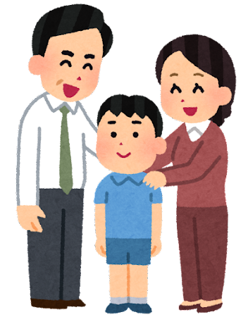
.
In this way, my family and teachers will think that I am a flexible and courageous person,
and appreciate that I can cope with the change positively.

Slide 9
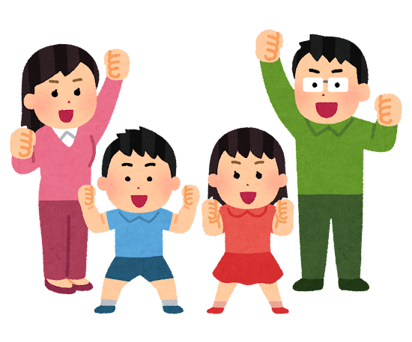
No mask? No Problem!
Stay positive, I can do it!

